Slide 1
Pointer
A pointer is a variable whose value is the address of another variable, i.e., direct address of the memory location.
The general form of a pointer variable declaration is
type *var-name;
Ex. int *ip; /* pointer to an integer */
double *dp; /* pointer to a double */
float *fp; /* pointer to a float */
char *ch /* pointer to a character */

Slide 2
How to Use Pointers?
(a) We define a pointer variable
(b) assign the address of a variable to a pointer
(c) finally access the value at the address available in the pointer variable.

Slide 3

#include <stdio.h>
int main () {
int var = 20; /* actual variable declaration */
int *ip; /* pointer variable declaration */
ip = &var; /* store address of var in pointer variable*/
printf("Address of var variable: %x\n", &var );
/* address stored in pointer variable */
printf("Address stored in ip variable: %x\n", ip );
/* access the value using the pointer */
printf("Value of *ip variable: %d\n", *ip );
return 0;
}

Slide 4
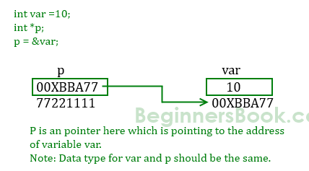
Pointer Concept

Slide 5
NULL Pointers
It is always a good practice to assign a NULL value to a pointer variable in case you do not have an exact address to be assigned. This is done at the time of variable declaration. A pointer that is assigned NULL is called a null pointer.

Slide 6
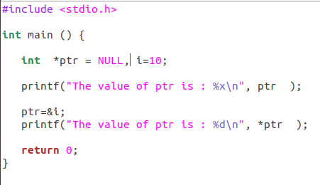

Example

Slide 7
Pointer arithmetic
There are four arithmetic operators that can be used in pointers: ++, --, +, -

Slide 8
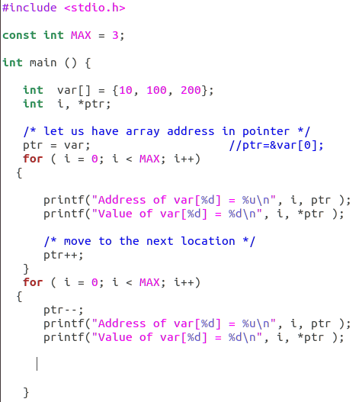
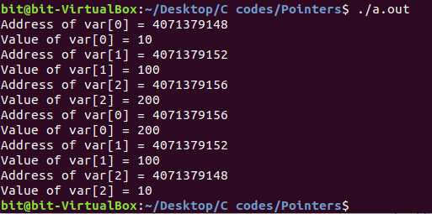

Slide 9
Pointer Comparisons
Pointers may be compared by using relational operators, such as ==, <, and >. If p1 and p2 point to variables that are related to each other, such as elements of the same array, then p1 and p2 can be meaningfully compared.

Slide 10
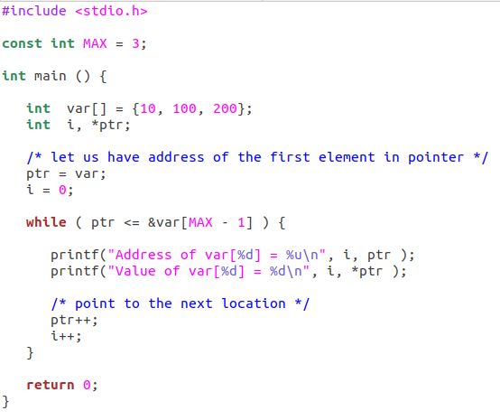
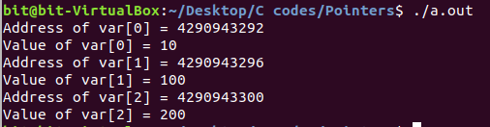

Slide 11
Pointer and Array

Slide 12
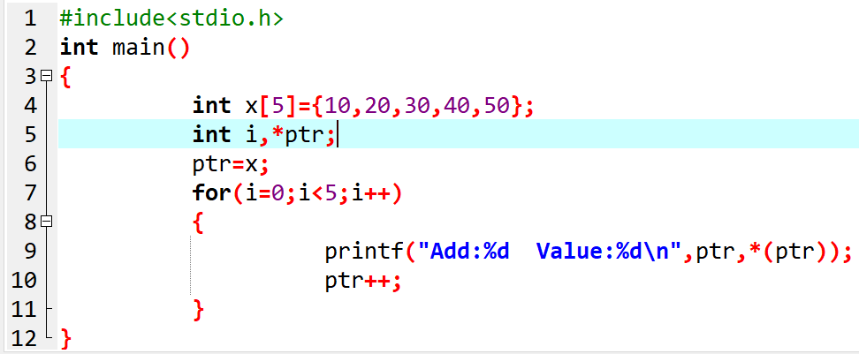
Pointer and array (1-D array)

Slide 13
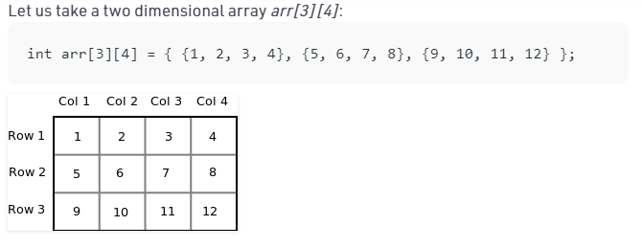
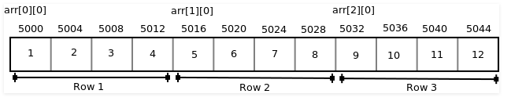
Pointer and 2-D array

Slide 14
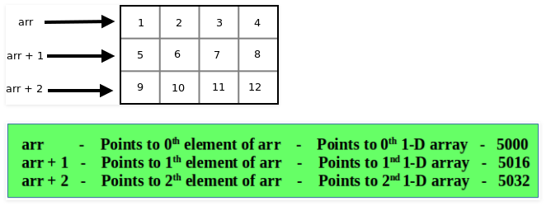
Contd.
int *ptr=&arr[0][0]
To access jth element of ith row->*(ptr+no. of column*i+j)
int (*ptr)[3]=arr
To access jth element of ith row->*(*(ptr+i)+j)

Slide 15
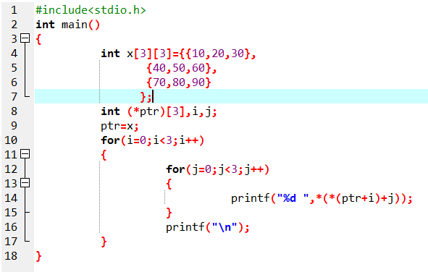
Pointer and 2-d array

Slide 16
Pointer and Functions

Slide 17
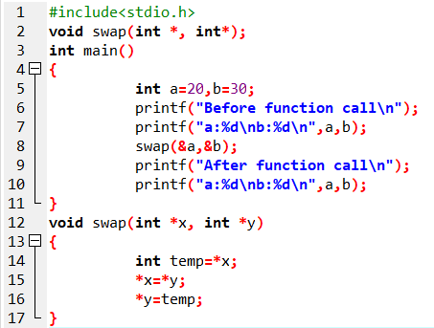
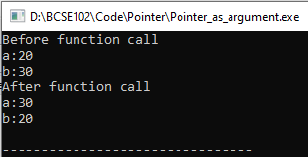
Pointer as Function arguments (Call by reference)

Slide 18
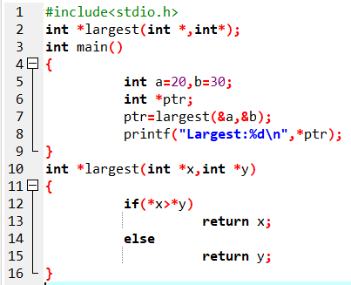

Functions returning pointers

Slide 19
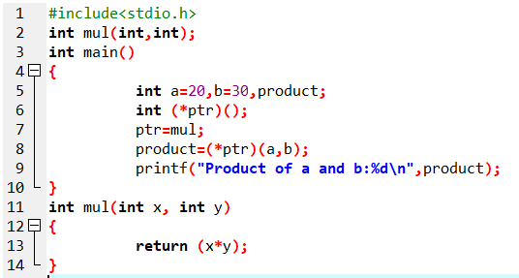

Pointers to functions

